Slide 1
Weekly report: Foundations
Week number: 03
Date: 07/10/2025
Supervisor: Prof. Dr.-Ing. Torsten Faber
Group members : Jehad Albaali- Amagad Gerges - Reda Deif
presented by : Amgad Gerges

Slide 2
List of contents
Soil Profile for Qattinah .
Soil proprieties for Qattinah
`Choose Type of Foundations .
Group members: Jehad Albaali- Amgad Gerges - Reda Deif
Foundations team/ Optimus Syria

Slide 3
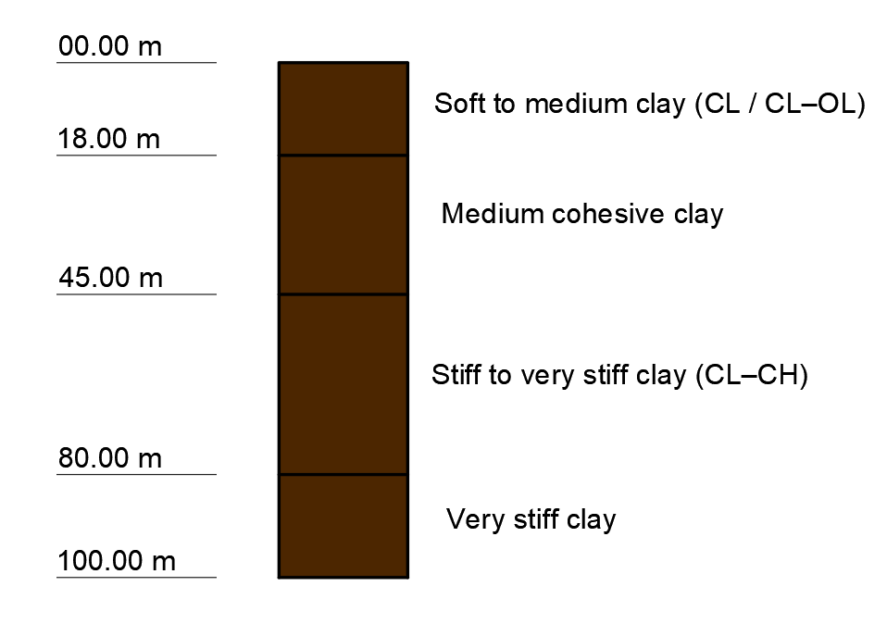
Soil Profile for Qattinah
Group members: Jehad Albaali- Amgad Gerges - Reda Deif
Foundations team/ Optimus Syria

Slide 4
Soil proprieties for Qattinah
Depth | Soil Type | Modul of Elasticity | Friction Angle | Cohesion | Density | Poisson Ratio
(m) |  | KN/m² | [°] | KN/m² | KN/m³ | 0.45
0 - 18 | Soft to medium clay (CL / CL–OL) | 7000 | 20º | 15 | 18 | 0.45
18 - 45 | Medium cohesive clay | 11,000 | 22º | 20 | 19 | 0.45
45 – 80 | Stiff to very stiff clay (CL–CH) | 20,000 | 24º | 25 | 20 | 0.45
80 – 100 | Very stiff clay | 25,000 | 26º | 30 | 21 | 0.40
Group members: Jehad Albaali- Amgad Gerges - Reda Deif
Foundations team/ Optimus Syria

Slide 5
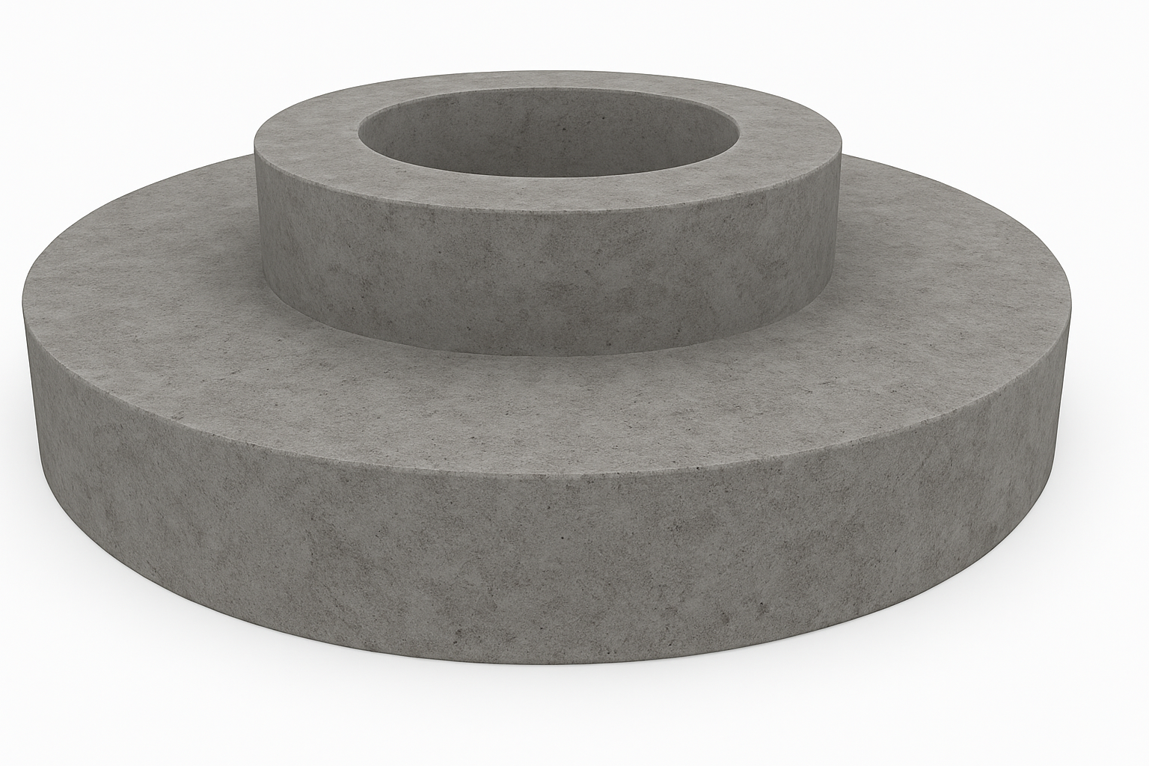
Choose Type of Foundations
The estimated type of foundation for our turbine will be shallow foundation type (mat with round shape)
Reasons for estimated shallow foundation type
More effective cost than deep foundation
Simple and Fast to Construct
we don’t need specialized equipment , which reduces construction time and cost
ground water is at depth 74.5 m so it will not be affected by ground water.
Reasons for estimated round shape type
Uniform Load and Moment Distribution
Smaller Perimeter for the Same Area ( amount of concrete and steel Rebar decrease )
Group members: Jehad Albaali- Amgad Gerges - Reda Deif
Foundations team/ Optimus Syria

Slide 6
Next Task
Estimation Concrete Dimensions depending on estimations loads
Estimation Weight of foundation
Group members: Jehad Albaali- Amgad Gerges - Reda Deif
Foundations team/ Optimus Syria

Slide 7
References
[1] Soil Grids, [Online]. Available: https://soilgrids.org/?utm
[2] Google, Google Maps. [Online]. Available: https://maps.google.com
[3] Google, Google Earth. [Online]. Available: https://earth.google.com/web/search/34%c2%b041%2749.6%22N+36%c2%b030%2730.0%22E/@34.67531382,36.5 980701,506.39690821a,3513.70885844d,35y,360h,0t,0r/data=CiwiJgokCTkQ2iOXWkFAEQndzvkBWEFAGYw3RwMnRE JAIQJ6D_SHPUJAQgIIAUICCABKCAjMjOyYBRAA
GGIS (Global Groundwater Information System) .: http://ggis.un-igrac.org/
Group members: Jehad Albaali- Amgad Gerges - Reda Deif
Foundations team/ Optimus Syria

